Slide 1



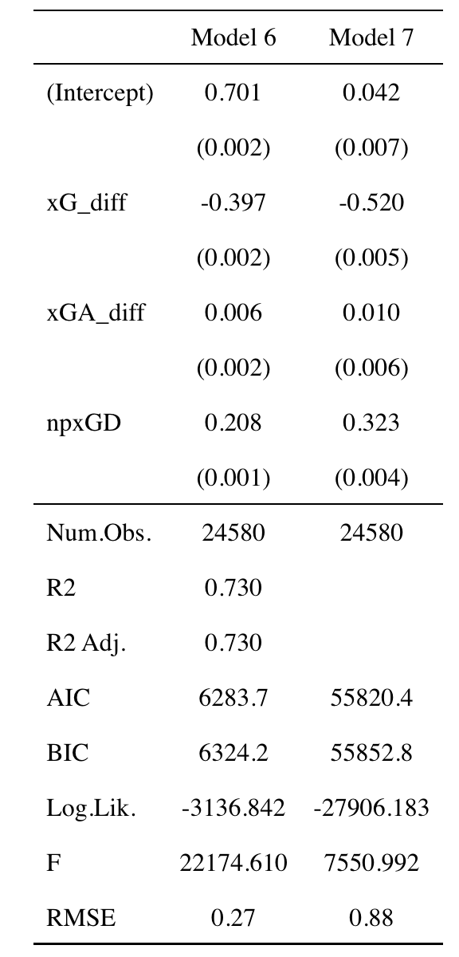
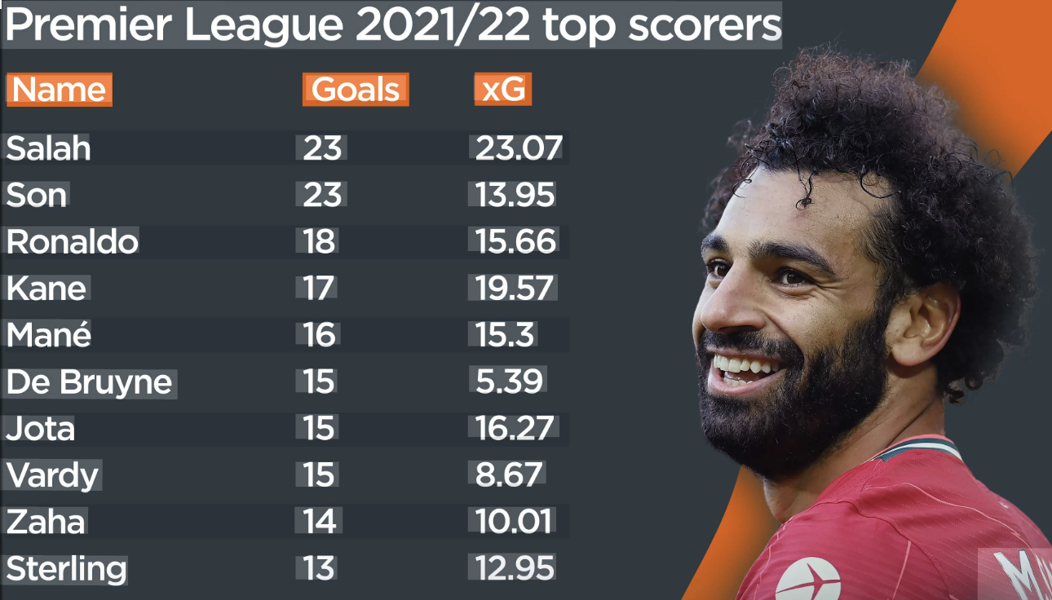

Jonathan L Auerbach

Jonathan L Auerbach
Jonathan L Auerbach
Does Expected Goals xG Predict Actual Goals ?
Abdullah Alshubaily
Statistics Major with Concentration Sports Analytics
RESULTS / DATA / EVIDENCE
Scatterplot shows strong positive relationship between xG and goals
Linear and Poisson models both confirm this trend
Mohamed Salah example shows players with high xG score more goals
Models show xG variables are statistically significant
xG predicts goals well, but randomness still exists
INTRODUCTION / LITERATURE REVIEW
One of the most popular metrics is Expected Goals (xG)
xG measures the quality of scoring chances based on factors like shot location and angle
Instead of only counting goals, xG estimates how many goals a team should score
This helps reduce randomness in soccer, where outcomes can be unpredictable
However, it is still important to test how well xG actually predicts real goals
.
I
PROCESS
Collected Understat match data (24,000+ observations)
Selected variables: goals, xG, and related metrics
Built multiple models: linear, polynomial, Negative Binomial Regression, Ridge Regression, and Poisson
Included pressing variables to improve analysis
Evaluated how well xG predicts goals
DISCUSSION/CONCLUSIONS
The results show that expected goals (xG) is a strong predictor of goals scored
The scatterplot and regression models both show a clear positive relationship
Models such as linear and Poisson regression confirmed that xG variables are statistically significant
Real-world examples, such as Mohamed Salah, support the results since players with higher xG tend to score more goals
However, xG does not perfectly predict goals because soccer includes randomness and unpredictability
Image from this posts
https://learning.coachesvoice.com/cv/expected-goals-xg-explained/
ACKNOWLEDGEMENTS
I would like to thank professor Jonathan L Auerbach for guidance and support throughout this project.
Finally, I acknowledge Understat for providing the dataset used in this analysis
Figure 3 Caption

